Slide 1
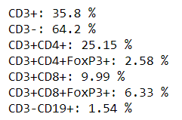
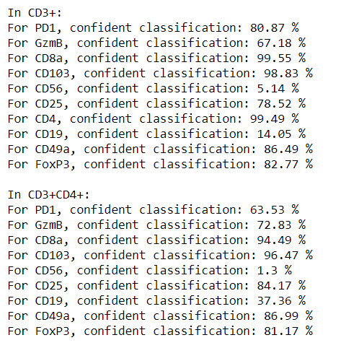
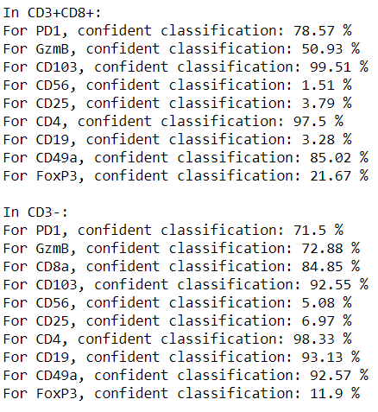
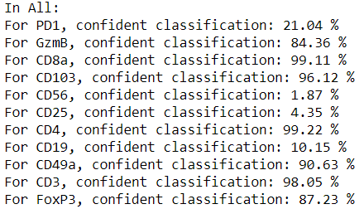
CD4+
PD1
CD4+
FoxP3+
Hierarchical 1-D GMM
Gating Scheme
CD3+
CD3+
CD45+
Gated Population %s
CD45+
CD8+
FoxP3+
CD3-
CD56
Confident Classification

Slide 2
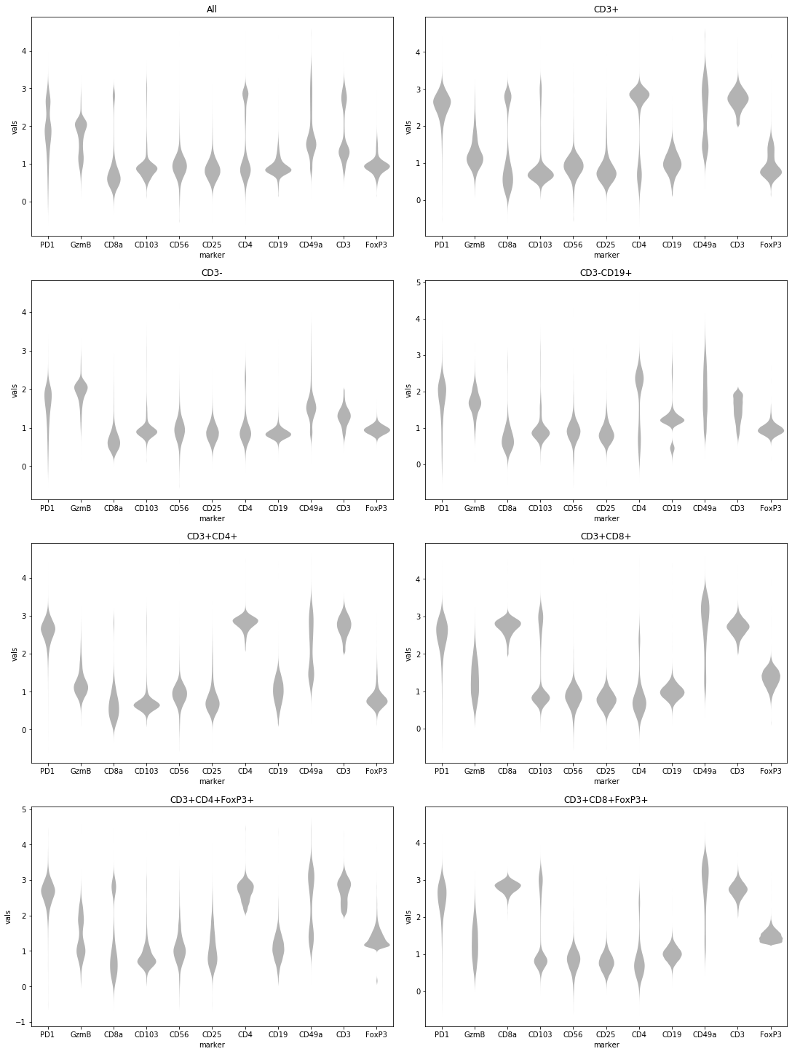
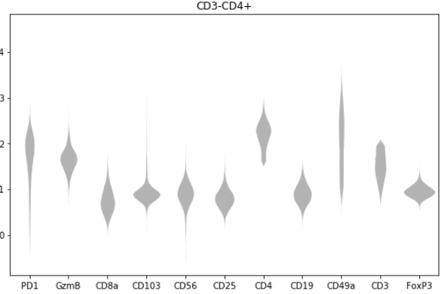
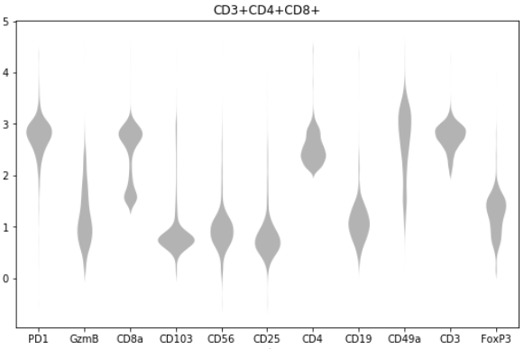
Corresponding Distributions

Slide 3
CD4+
GOAL: Figure out the nature of marker correlation
Not easy to do it with 11 markers together
Let’s try using popular gate CD3+CD4+ as a base and exploring correlation from there (in the other 9 markers)
Idea: Use posterior probs of 1-D GMM classification for each marker as new axes (affine space). Correlation manifolds might be easier to see here.
(p,1-p) simplex effectively yields a single p for each cell for each axes.
CD3+
CD45+

